Slide 1

[ Start Installation ]

Slide 2



Windows 6
Install windows 6
Install

Slide 3
This Will Take A Few Seconds..

Slide 4
Checking Compatibility..

Slide 5
Done.

Slide 6
Welcome
Windows 6 Ultimate

Slide 7





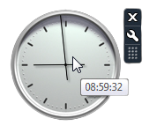

Internet Explorer
File Explorer
8:59AM 11/16/2023

Slide 8
Windows 6 Setup Screen
Fixing Windows 6…
Undo Repair

Slide 9
8:59AM 11/16/2023

